Slide 1

Satellite Image Classification with CNN, Grad-CAM, and Multimodal Explanations
Priyanshi Patel

Slide 2



Project Overview
This capstone project applies deep learning to satellite image classification using a ResNet18-based CNN. It integrates Grad-CAM for visual explanations and BLIP, a multimodal LLM, for natural language descriptions, covering the full deep learning pipeline from data preprocessing to evaluation.
CNN Classification
Grad-CAM
BLIP LLM
Classify satellite images into 10 land-use categories.
Generate visual explanations of model decisions.
Integrate multimodal LLM for natural language descriptions.

Slide 3

Dataset and Preprocessing
EuroSAT Dataset
Data Preprocessing
Selected from Torchvision, it contains over 27,000 satellite images across 10 land use classes. A subset of ~1000 images per class was used.
Images resized to 64x64 pixels.
Pixel values normalized.
Data split: 70% training, 15% validation, 15% testing.
AnnualCrop
Augmentation: random horizontal flips, rotations, brightness changes.
Forest
HerbaceousVegetation
Highway
Industrial
Pasture
PermanentCrop
Residential
River
SeaLake

Slide 4
Model Selection and Training
ResNet18 Architecture
Model Training
A CNN based on ResNet18 was customized for 10 classes.
Trained for 30 epochs using Adam optimizer and CrossEntropyLoss.
Convolutional layers with ReLU activation.
Residual blocks for deep feature extraction.
Early stopping based on validation accuracy to prevent overfitting.
Dropout for regularization.
Loss and accuracy monitored per epoch.
Final softmax classification layer.

Slide 5

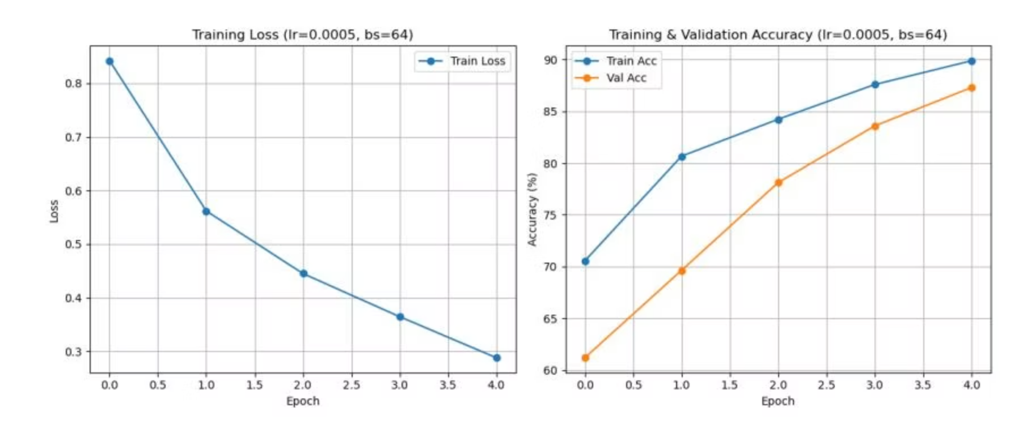
Hyperparameter Tuning
Random search was performed over learning rate (0.001 to 0.0001) and batch size (32, 64, 128).
0.0005
64
87.30%
Learning Rate
Batch Size
Validation Accuracy
The combination of learning rate = 0.0005 and batch size = 64 achieved the highest validation accuracy.

Slide 6
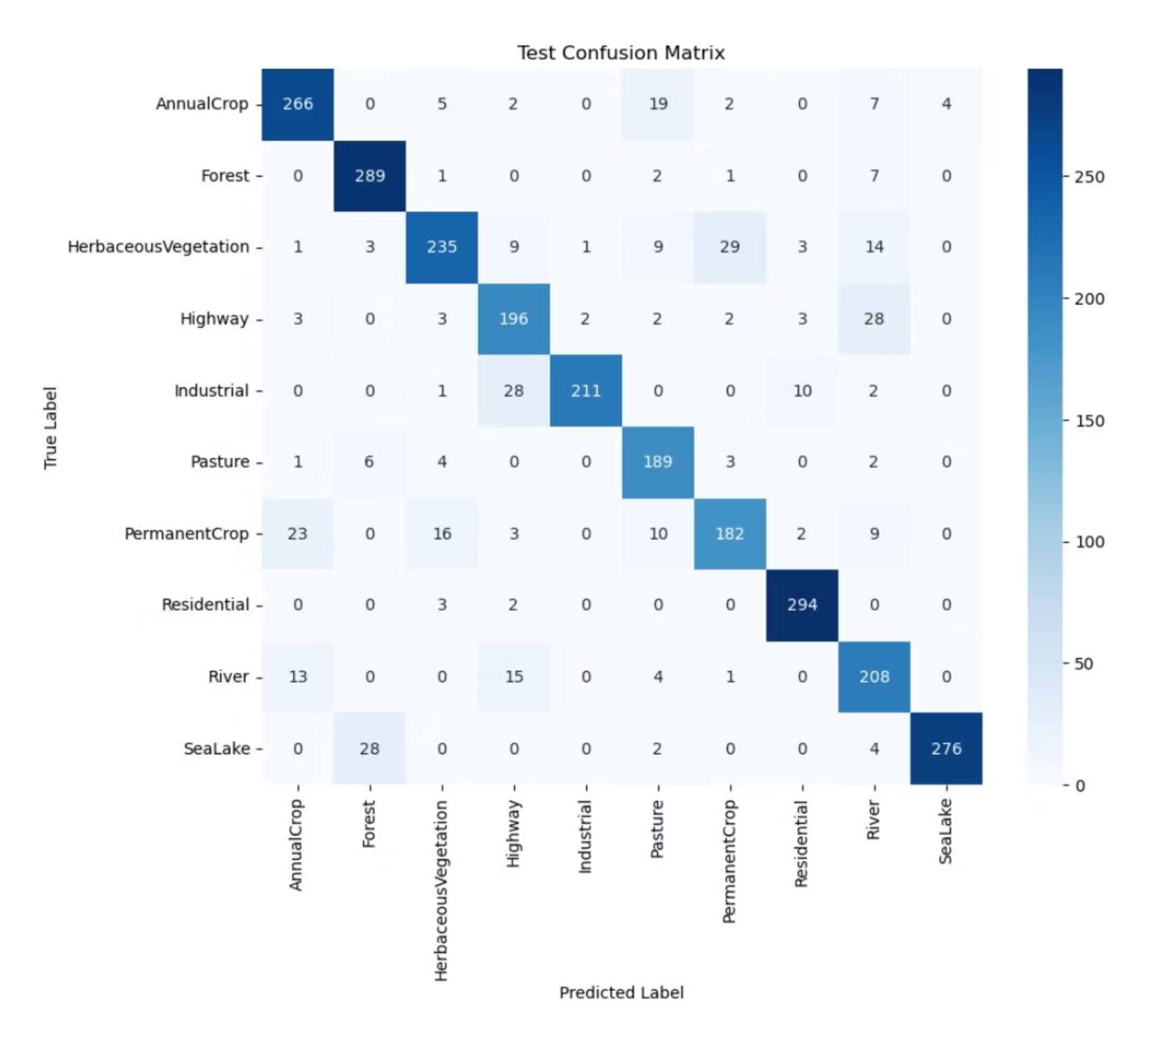
Model Evaluation
The model achieved strong performance on both validation and test sets.
87.30%
86.89%
Validation Accuracy
Test Accuracy

Slide 7

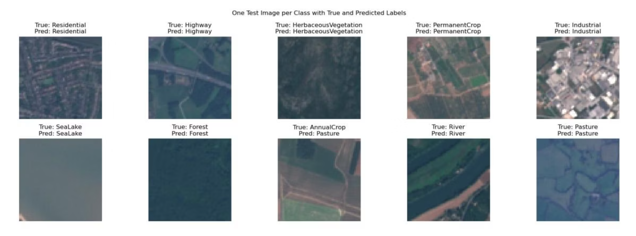
Confusion Matrix Analysis
The confusion matrix details classification performance, showing correct and incorrect predictions for each class.
High diagonal counts indicate reliable distinction between most classes. Misclassifications, like between HerbaceousVegetation and Pasture, are expected due to visual similarities.

Slide 8
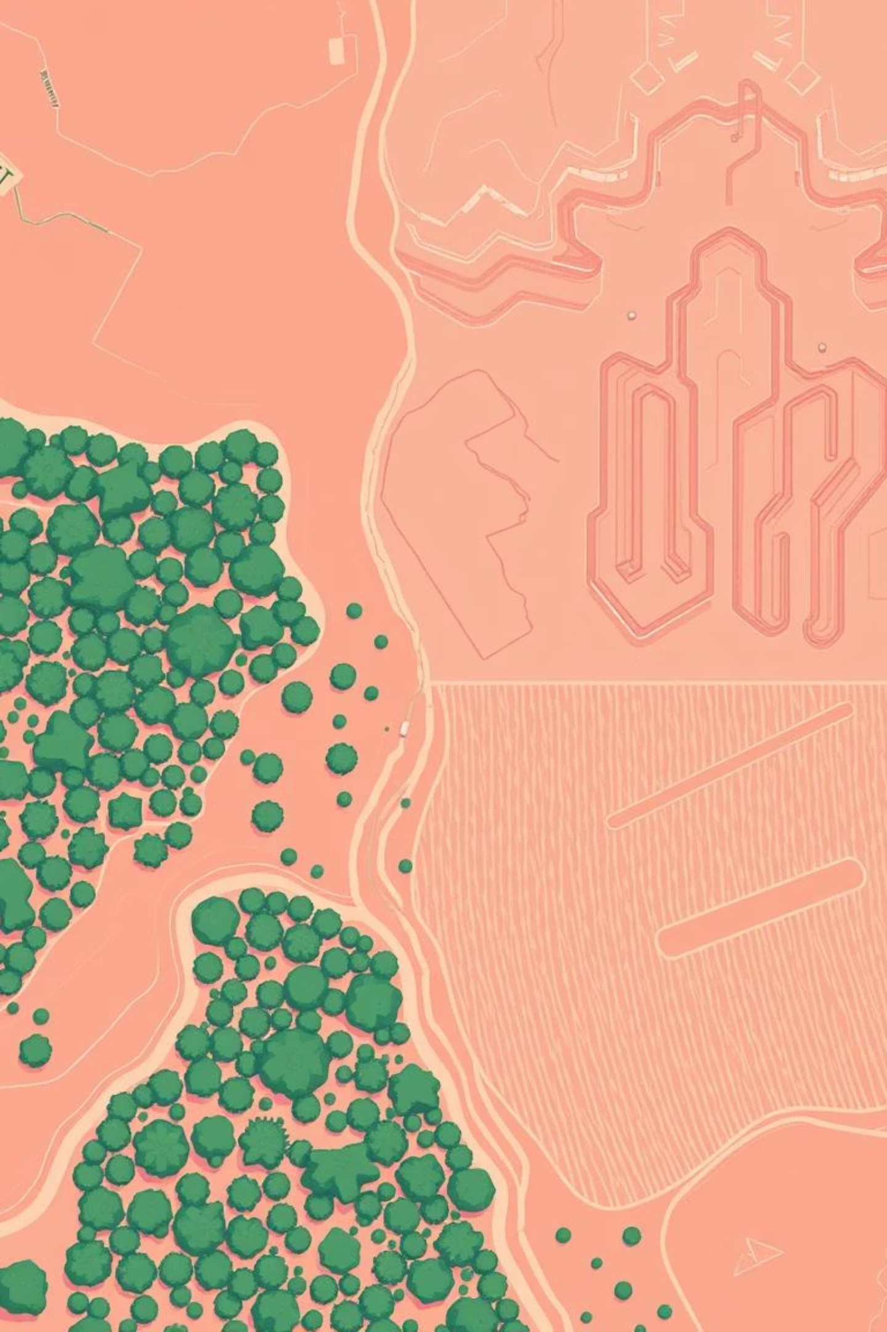
Fine-Tuning and Final Testing
Misclassifications were primarily in visually similar categories. Retraining with increased dropout and minor learning rate decay tuning improved generalization.
Generalization Improved
Increased dropout and minor learning rate decay tuning.
Final Test Accuracy
Achieved 86.89%, confirming robustness of the pipeline.

Slide 9
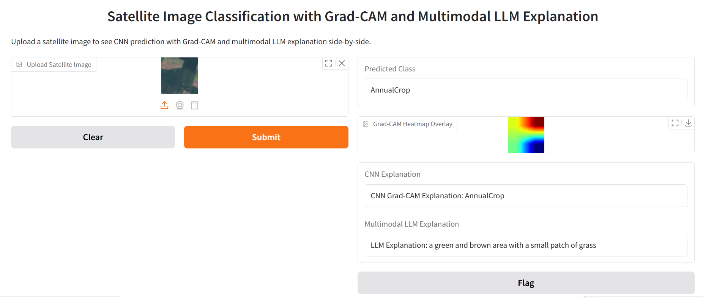
Multimodal LLM (BLIP) Explanations
The BLIP model generates natural language captions, complementing Grad-CAM heatmaps with semantic context for enhanced interpretability.
Interactive Gradio Interface
CNN's predicted land-use class.
Grad-CAM heatmap overlay.
Textual explanation from CNN's Grad-CAM.
Natural language caption from BLIP LLM.
Live Demo: Click here to open the interactive Gradio app.

Slide 10
Conclusion and Future Work
This project demonstrated CNN effectiveness in satellite image classification, with Grad-CAM and BLIP adding crucial interpretability.
Future Enhancements
Utilize pretrained backbones (e.g., ResNet50, Vision Transformers).
Test on higher-resolution imagery.
Incorporate temporal or multi-spectral satellite data.

